Slide 1

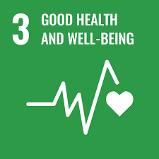
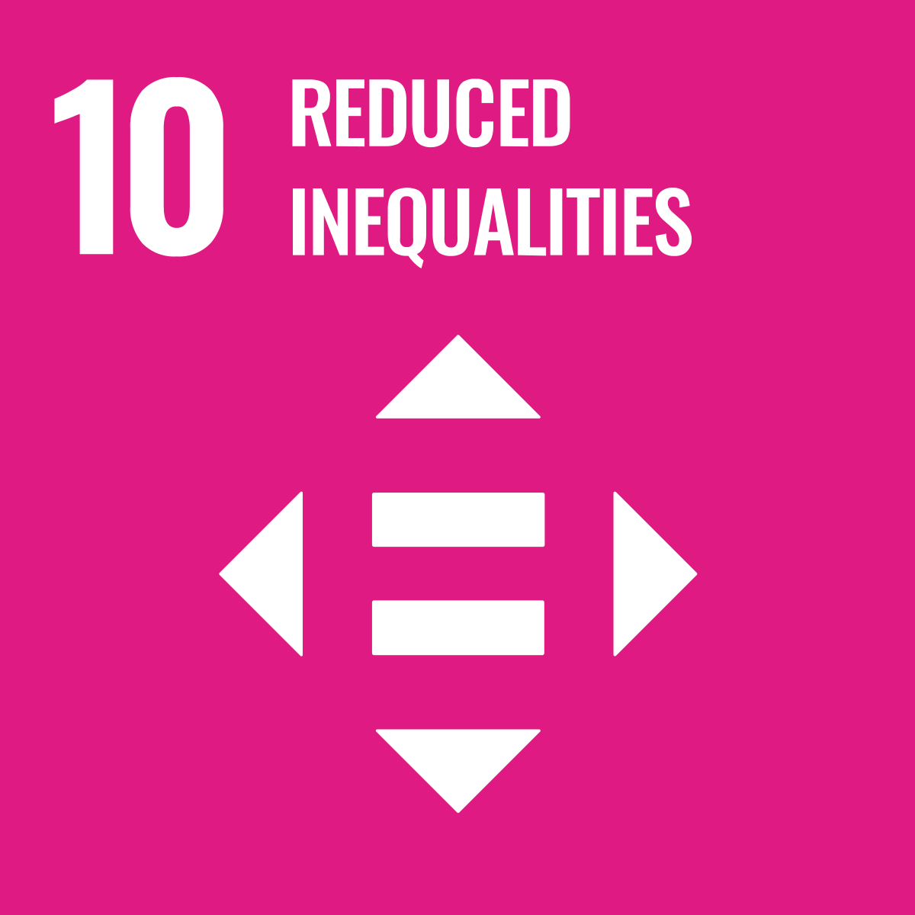


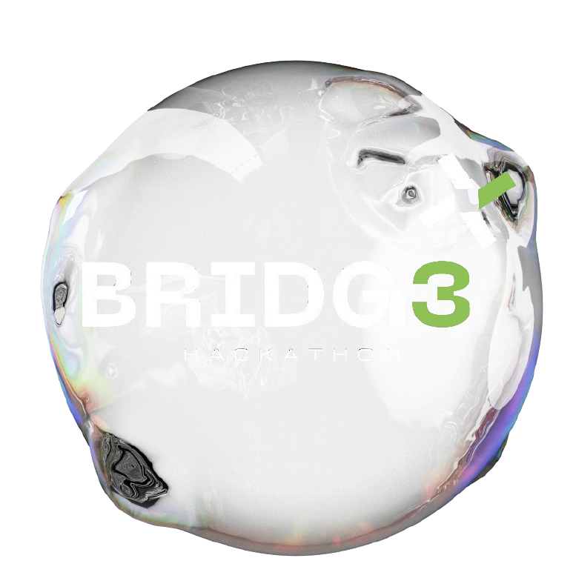


Powered By
Brought to you by
FeatureMining
Notes:
HealthMe, I have no money to pay the medical bill.
We all want to make a difference. We donate with the purest intentions, hoping to ease suffering and create change. But what if your good intentions are funding something entirely different? What if the money you're giving to help others is actually being taken out and fueling something harmful? This is the harsh reality of many donation black holes. Here with HealthMe, we aim to tackle the lack of transparency issues of healthcare donation platforms with MasChain. Our ultimate goal is to work towards SDG3 – Good health and also SDG10 – Reduced inequalities.

Slide 2

Problem Statement
TRUST DEFICITS?
SECURITY?
TRANSPARENCY? SLOW?
Donate
Distribute
Donor
Charity Fundraiser
Recipient
Governance & Transparency
The GT index of Malaysia NPO: 10 (Singapore 85)
Lokman, N., Othman, S., & Mohd Kamal, N. (2023). Governance, Accountability and Transparency Level of Non-Profit Organisation: A Study Of Malaysian Foundations. International Journal Of Business And Technology Management, 5(1), 304-318. Retrieved from https://myjms.mohe.gov.my/index.php/ijbtm/article/view/21953
Brought to you by
FeatureMining
Notes:
So, what exactly is the problem with existing donation platforms? In a typical donation process, donors will give money to a charity fundraiser, and that charity then gives it to a recipient in need. Firstly, donation processes are always slow. The charity fundraiser has to wait for donors to pump in money, which may take weeks and even months. The next thing is that transparency and security are always an issue. There is just no way to tell whether all of your money has actually reached the recipient and is put to good use. According to research by Lokman in 2023, the governance & transparency index of Malaysia non-profit organizations is only 10, as compared to Singapore with 85. With HealthMe, we plan to close that gap in the coming years.

Slide 3
Solution -
Record All Transaction
Return Acceptance Receipt
Cashed Out
Donor
Donate
Charity Fundraiser
Distribute
Recipient
Brought to you by
FeatureMining
Notes:
Our solution is to use Maschain to record all transactions, ensuring transparency and accountability. All donations to our platform will be tokenized, and we want users to be able to track where every cent of their donation is going. But this isn’t new, so why should you use our blockchain donation platform?

Slide 4

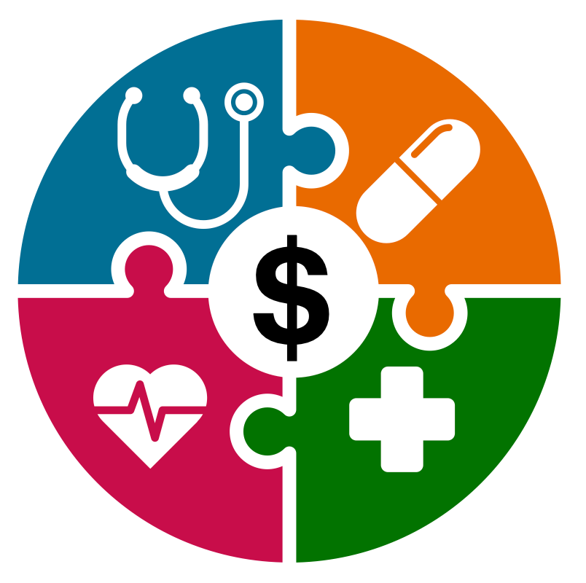
Novelty -
Donor A
Recipient A
Amount: | RM200,000.00
Domain: | Brain
List of Criteria:
Age | < 80
Disability | Yes, with proof
Pay To | Hospital
Amount: | RM30,000.00
Domain: | Brain
Applicant:
Age | 54 [proof]
Disability | Yes [proof]
Matched!
It can be stacked!
Recipient B
Amount: | RM30,000.00
Domain: | Kidney
Applicant:
Age | 44 [no proof]
Disability | No
Machine Learning assists
in generating the list of criteria!
Brought to you by
FeatureMining
Notes:
What’s special about HealthMe is that on top of blockchain, we are also integrating Machine Learning to help make the donation process much faster, for both the donor and the recipient. How this works is that donors will have a pool of funds in our platform, with criteria to whom they want to donate to. When new requests for donations come in, HealthMe will match them to receive the suitable funds, and then the hospital will receive the payment directly. With this novelty, we aim to revolutionize the way donations has been done all these years.

Slide 5
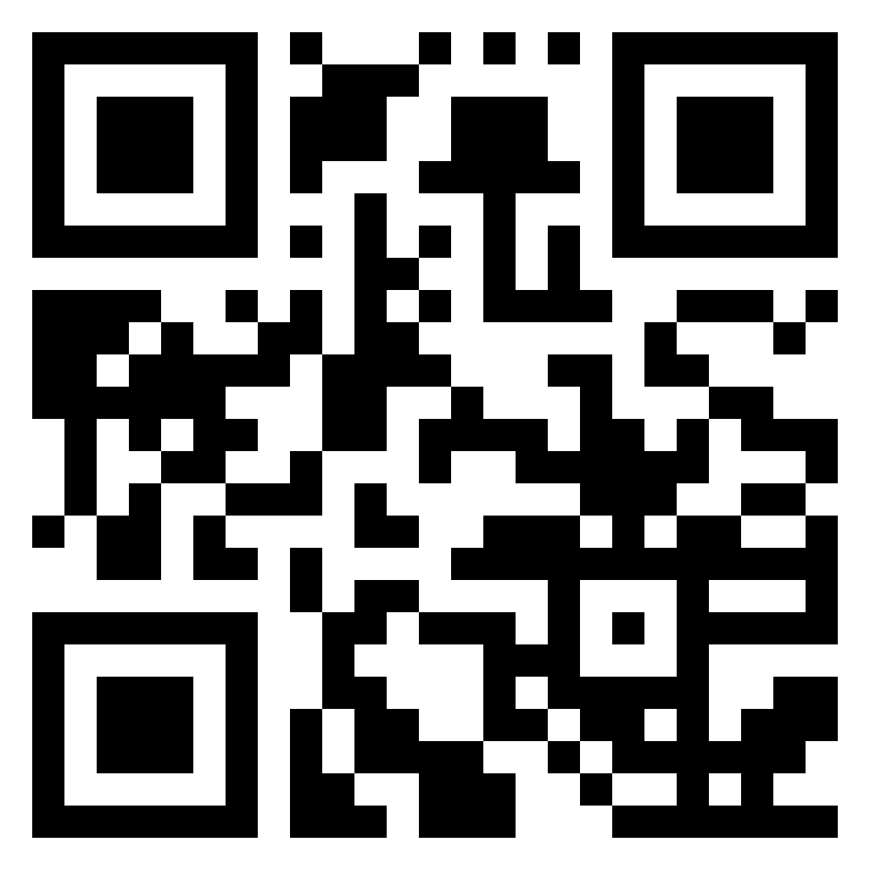
Powered By
https://healthme-funds.web.app
Brought to you by
FeatureMining
Notes:
Now, we proceed to the live demo. You may play along with us using this QR code.
HealthMe is more than a platform; it's a promise. A promise of transparency, efficiency, and impact. Let's build a future where every donation counts. Join us in revolutionizing the way we give back.

